Slide 1
Roundtable Presentation
Hawk Wei

Slide 2
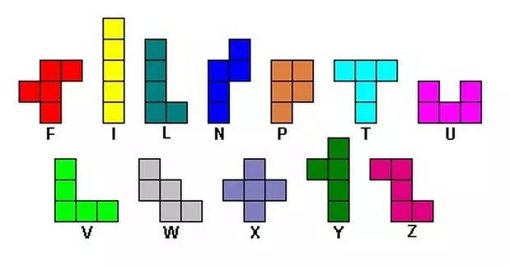
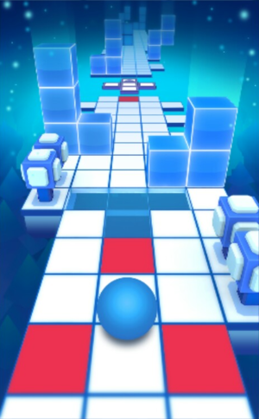
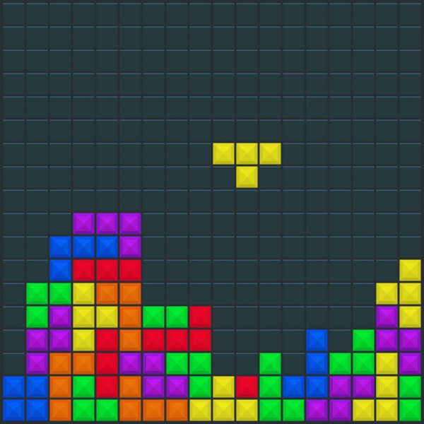
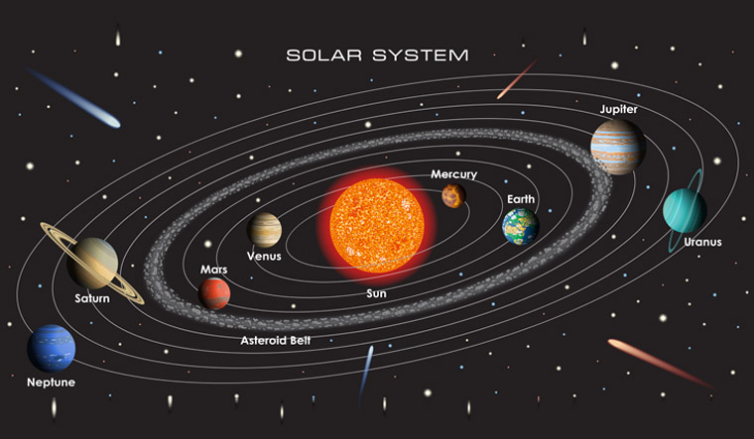
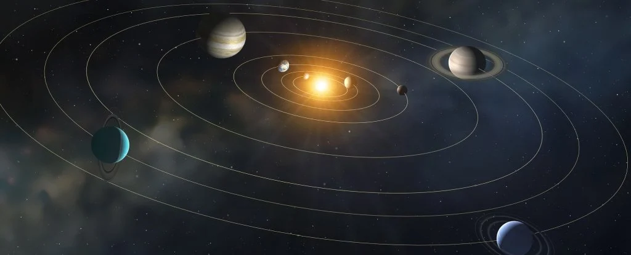
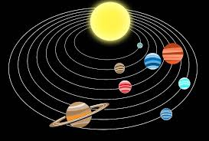
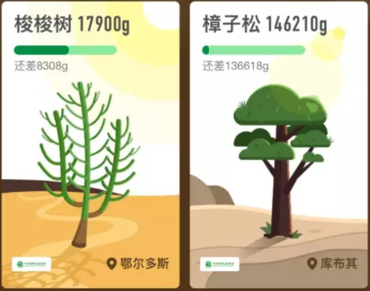
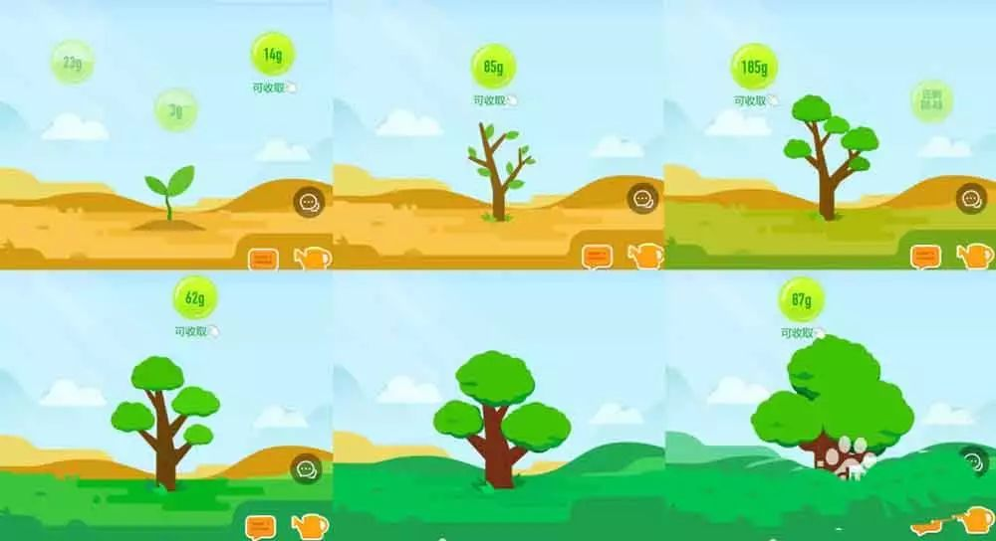
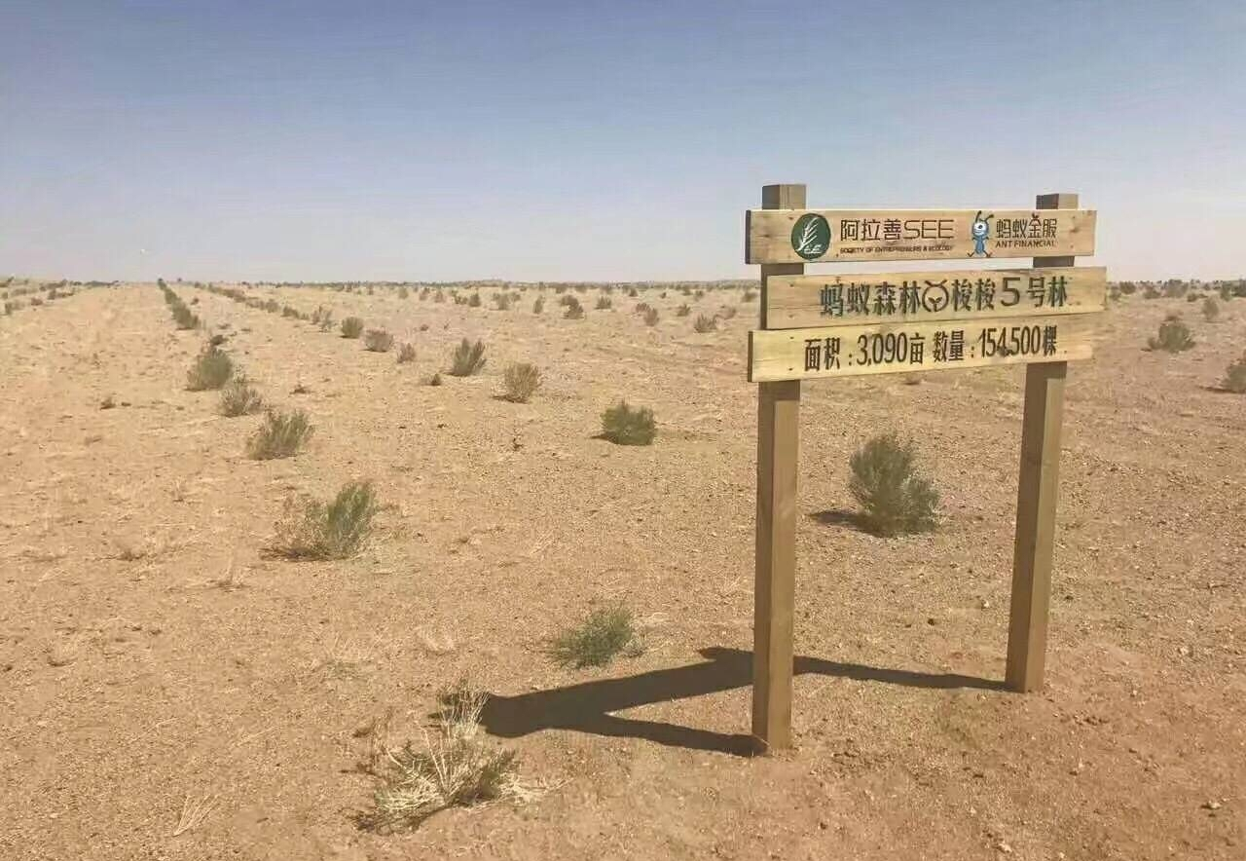

Slide 3
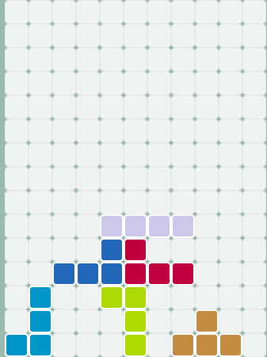
Idea 1- High Score
Tetris game
I am thinking of develop my Tetris game further and making it a very fancy game.
It will have many reactions with time and human control
https://tetris.com/play-tetris

Slide 4
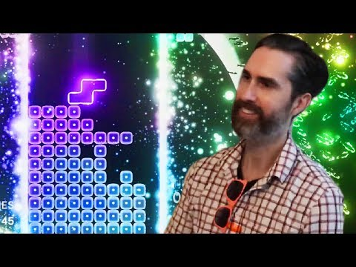

Slide 5
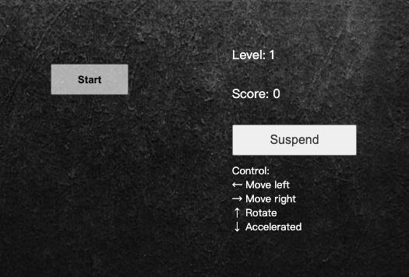
Interaction
This software should interact with human control by keyboards.

Slide 6
References Concept
It has become very common from back when Alexey Pajitnov first made it in 1984.With over 170 million copies sold, it is the 2nd best-selling video game of all time.
The Tetris® Effect is a catchy term that players use to describe the way they are inspired by the game and see Tetriminos in everyday situations. Because Tetris, like the real world, challenges players to make order out of chaos using a specific organization system, the game components translate easily into lifestyle interpretations.

Slide 7
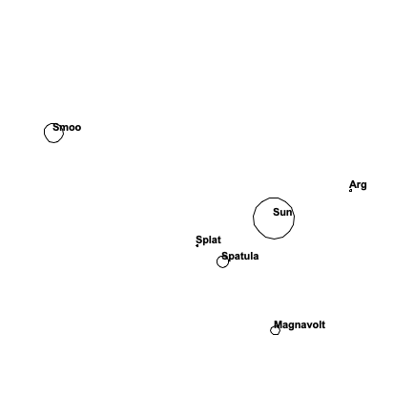
Idea 2- Own adventure
I am thinking of making a module of solar system.
It can present how planet and star moving with gravity.

Slide 8
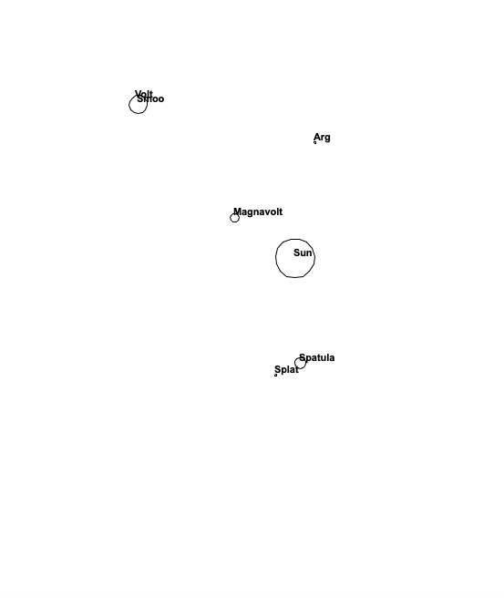
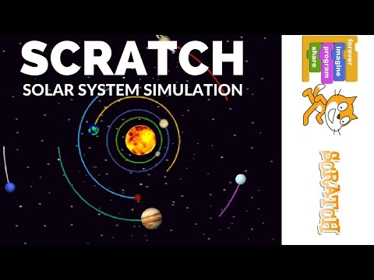
Interaction with time
The system will occur by timing and it will shows very amazing moving.

Slide 9
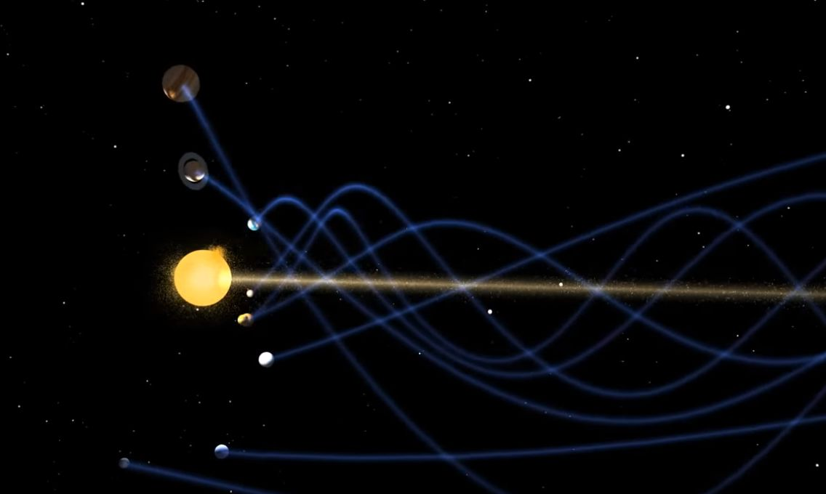
References
At the center, gravity pulled more and more material in. Eventually the pressure in the core was so great that hydrogen atoms began to combine and form helium, releasing a tremendous amount of energy. With that, our Sun was born, and it eventually amassed more than 99 percent of the available matter.

Slide 10
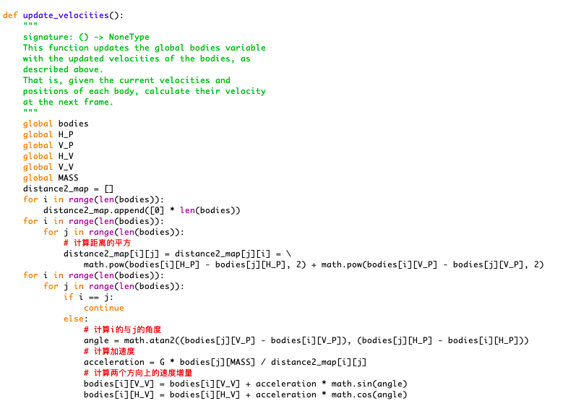
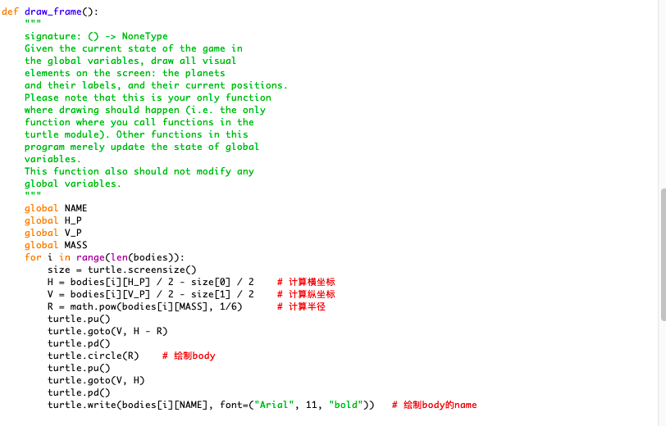
Code
I was trying to express it with code and images.

Slide 11
Idea 3 -Interactive Narrative
A platform that users are allowed to save their spare time of their phone and use this to plant trees around world.
Also, apple pay, venmo or any smart phone app using with connection with this app will give energy.

Slide 12
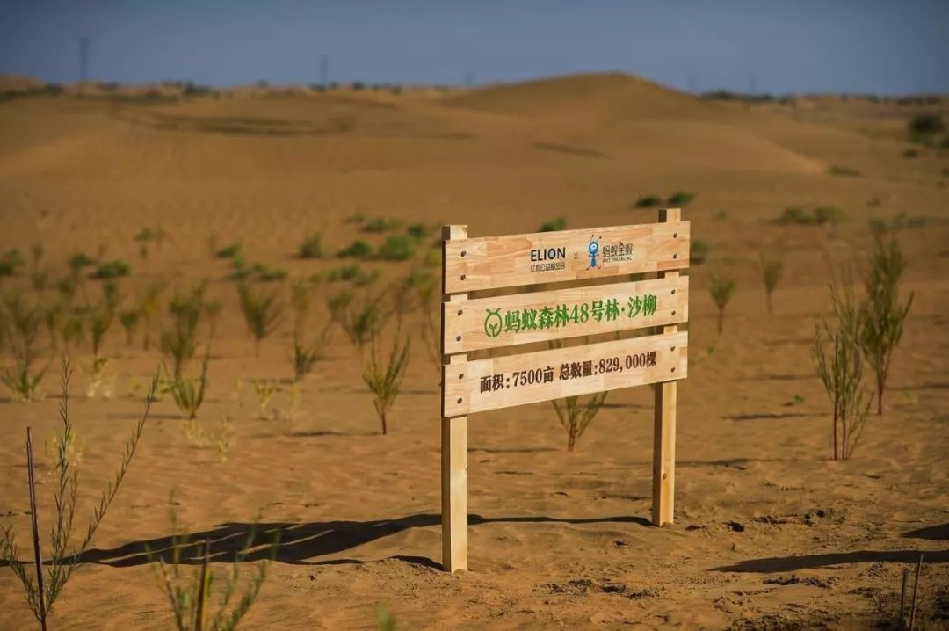
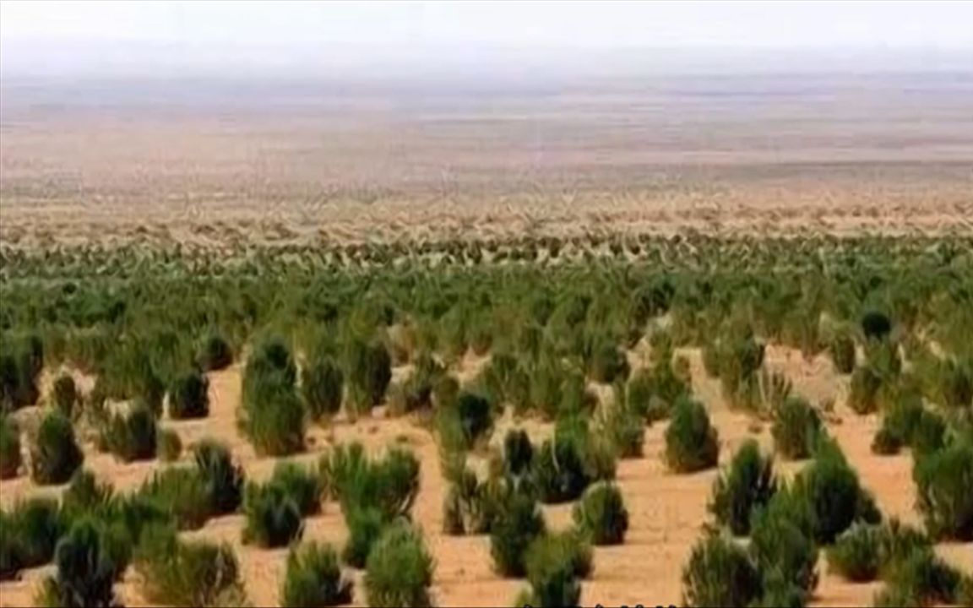
What it seem like

Slide 13
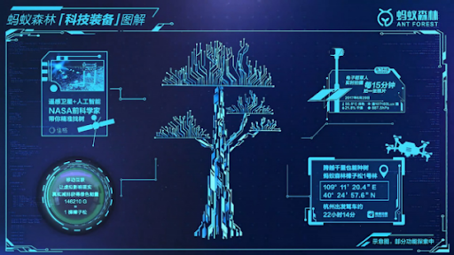
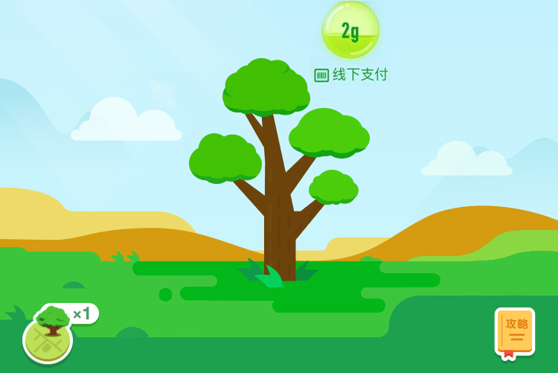
Interaction with time and user preference

